Slide 1
Movie Review Sentiment Analysis
A Machine Learning Approach using Streamlit

Slide 2
What is Sentiment Analysis?
Sentiment Analysis (also called opinion mining) is a branch of Natural Language Processing (NLP) that focuses on determining the emotional tone behind words. It’s used to understand whether a piece of text expresses a positive, negative, or neutral sentiment.
How Sentiment Analysis Works
1. Text Input:
The system receives a sentence, review, or tweet as input
Example: "The movie was amazing!"
2. Text Preprocessing:
Clean the text by Removing punctuation, converting to lowercase & removing stopwords (e.g., "the", "is", "and")
3. Feature Extraction:
Convert words into numerical format using techniques like Bag of Words, TF-IDF
4. Model Prediction:
A trained machine learning or deep learning model analyzes the features and predicts the sentiment: Positive, Negative

Slide 3
Why Movie Reviews?
1. Opinion-Rich Content: Movie reviews express clear emotions, making them ideal for analyzing sentiment.
2. Easily Available Datasets: Large public datasets like IMDB are freely available for training and testing.
3. Labeled Data: Reviews often come with star ratings that can be mapped to sentiment (positive/negative).
4. Practical Use Case: Helps users decide what to watch and gives feedback to filmmakers and platforms.
5. Good for Learning: Simple structure and real-world data make it great for beginners in NLP and ML.
6. Perfect for Deployment: Enables building and deploying complete ML apps with tools like Streamlit. convert this text into normal font

Slide 4
Project Objective/Goal
1. To build an automated Sentiment Analysis system that can classify movie reviews as positive or negative.
2. To deploy the model in an interactive web application using Streamlit for real-time predictions.
3. To apply machine learning and NLP techniques to develop a robust, scalable solution for sentiment analysis.
Project Goals:
Data Collection: Collect a dataset of labeled movie reviews (positive/negative).
Text Preprocessing: Clean the reviews (remove punctuation, lowercase, stopwords) to make them suitable for analysis.
Model Training: Train a machine learning model (Logistic Regression) to classify sentiments.
Model Serialization: Save the trained model and vectorizer using serialization techniques for faster reuse.
Deployment via Streamlit: Create an interactive web app using Streamlit where users can input reviews and receive predictions in real-time.
Evaluation and Improvement: Evaluate the model's performance using metrics like accuracy, precision, and recall, and iterate to improve it.

Slide 5
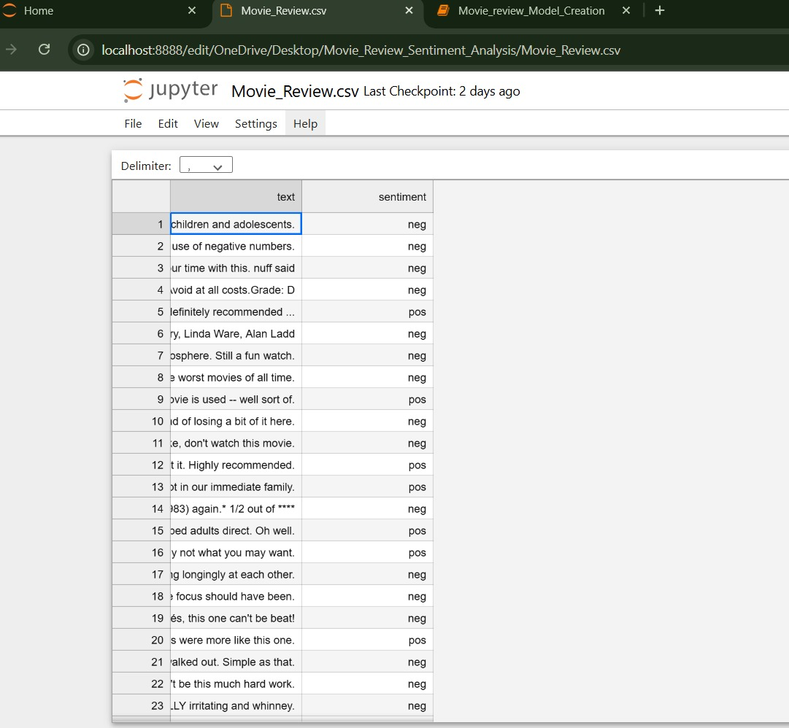
Dataset Description
Dataset Source: Kaggle Structure: Contains text reviews labeled as 0 (Negative) or 1 (Positive)
1. Type of Dataset: Text-based dataset containing movie reviews.
2. Main Columns:
Text: Contains the actual movie review.
Sentiment: Label indicating if the review is positive (pos) or negative (neg).
3. Number of Entries:
Around 50,000 reviews – evenly split between positive and negative.
4. Data Source:
Sourced from Kaggle or similar open platforms.
5. Preprocessing Required:
Removing nulls, cleaning text, removing stop words, and converting to numerical form using TF-IDF vectorization.

Slide 6
Data Preprocessing
1. Remove Unwanted Characters: Cleaned the movie reviews by removing punctuation marks, special symbols, numbers, and HTML tags to ensure only useful text is kept.
2. Convert to Lowercase: Standardized the text by converting everything to lowercase. For example, "Great Movie!" and "great movie!" are treated the same.
3. Remove Stop words: Removed common words like "is", "the", "and", "of" which do not contribute to the sentiment of the review.
4. Tokenization: Broke down each review into individual words (tokens) for better analysis. Example: "The movie was amazing" → ["the", "movie", "was", "amazing"]

Slide 7


Engineering using TF-IDF
What is TF-IDF?
TF-IDF is a technique used to convert text into meaningful numerical features. It highlights words that are important in a document (a single review) but not common across all documents (the entire dataset).
1.Term Frequency (TF):
Shows how often a term appears in a single document.
​
2. Inverse Document Frequency (IDF):
Reduces the weight of common terms and increases the weight of rare terms.
Where:
N = Total number of documents (reviews)
df(t) = Number of documents containing term t

Slide 8

TF-IDF CONTD:
3. TF-IDF Score:
Example:
Imagine the word "amazing" appears:
3 times In a review with 100 words -TF= 3/100 = 0.03
In 500 out of 50,000 reviews-IDF= 50000/500 = log(100)= 2
So, TF-IDF(“amazing”)= 0.03*2 = 0.06
Why TF-IDF Is Used in this Project:
1. Converts textual reviews into numeric form
2. Helps the model focus on unique, sentiment-heavy words like “amazing”, “terrible”, “boring”
3. Common words like “the”, “and” get lower weight
4. Works well with ML models like Logistic Regression

Slide 9
IMAGE 1 vs IMAGE 2
IMAGE 1 | IMAGE 2
Raw Data | TF-IDF
Common Words Overall | Important Words
Redundant Words are Present | Redundant Words are Absent
Informative Words are not Highlighted | Informative Words are Highlighted
Use-fullness for model is low due to more noise | Use-fullness for model is high due to less noise

Slide 10
Model Selection - Logistic Regression
What is Logistic Regression?
Logistic Regression is a supervised machine learning algorithm used for classification tasks. In this project, it is used to classify movie reviews as either Positive (1) or Negative (0) based on the text content.
Why Logistic Regression?
Simple & Interpretable: Easy to understand and interpret the relationship between input features (words) and output (sentiment).
2. Efficient for Text Data: Works well with TF-IDF vectors, which represent large sparse datasets (like reviews).
3. Probability Output: It gives a probability score between 0 and 1, which is ideal for binary classification.
4. Fast & Lightweight: Compared to deep learning models, it's faster and requires less computational power.

Slide 11
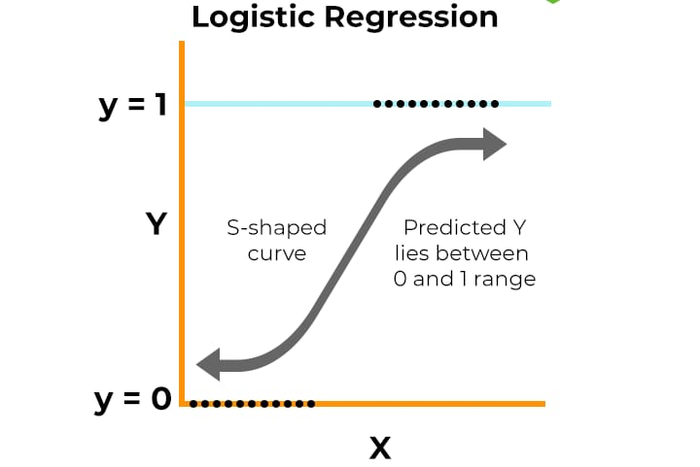
How does Logistic Regression work?
Logistic Regression takes numerical input features (TF-IDF scores of words).
It calculates a weighted sum of these features and passes it through a sigmoid function.
The sigmoid function outputs a value between 0 and 1.
Based on a threshold (usually 0.5), the review is classified as:
0 (Negative) if the output < 0.5
1 (Positive) if the output ≥ 0.5

Slide 12
In this project,
1. After cleaning the text, reviews are converted to TF-IDF vectors.
2. Logistic Regression is trained on these vectors and their actual sentiment labels.
3. When a new review is entered, the model uses these weights to predict its sentiment.

Slide 13
Model Serialization
Model serialization is the process of saving a trained machine learning model to a file.
Purpose: Allows the model to be saved to disk after training so that it can be loaded and used later without retraining.
Process:
1. Train the sentiment analysis model (e.g., Logistic Regression, SVM) on the preprocessed data.
2. Serialization: Serialize the trained model after it has achieved satisfactory performance.
3. Loading & Prediction: When new reviews need to be classified, load the saved model and perform predictions.
Files Saved:
model.pkl: This file contains the trained Logistic Regression model, which can be loaded into the app for making predictions.
scaler.pkl: This file stores the TF-IDF vectorizer, which converts raw text into numerical features that the model can understand.

Slide 14
Web Application using Streamlit
What is Streamlit?
Streamlit is a Python library that helps you quickly build interactive web apps for data science and machine learning projects , all using simple Python code.
Why Use Streamlit in This Project?
1. Create a user-friendly interface where anyone can enter a movie review.
2. Load the serialized model and make predictions instantly.
3. Display results (Positive / Negative) in real-time with just one click — no need for HTML, CSS, or JavaScript.
Workflow:

Slide 15
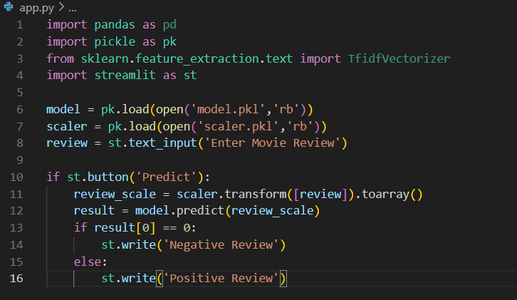
Streamlit Code Overview
Main Components:
load_model() function to import serialized objects
predict_sentiment() to process input and return result
User input box, buttons, and display functions

Slide 16
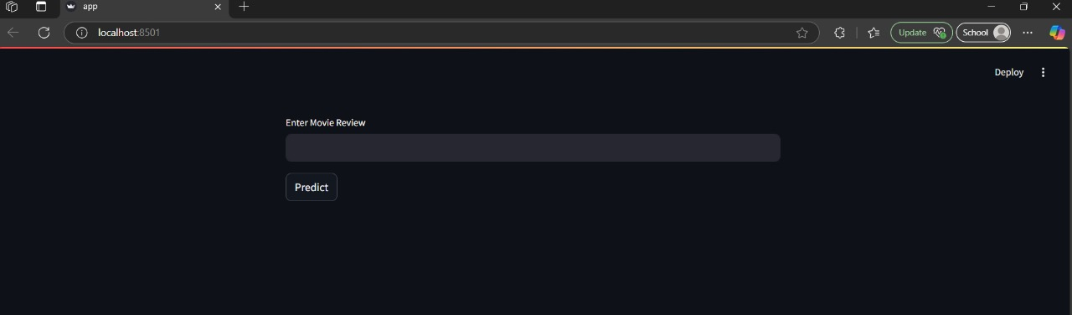
App Demo
Review input field
Predicted sentiment output
User-friendly layout

Slide 17
Chart

Slide 18
Conclusion
1. Developed a Movie Review Sentiment Analysis system to classify user reviews as positive or negative.
2. Applied Natural Language Processing (NLP) techniques for text cleaning and vectorization.
3. Trained a machine learning model (e.g., Logistic Regression or Naive Bayes) using processed movie review data.
4. Used model serialization to save the trained model and vectorizer for future use.
5.Built a clean, interactive web application using Streamlit for real-time prediction.
6.Enabled users to test the model by simply entering a review — no technical knowledge required.
7.Delivered a complete, end-to-end ML project integrating data science, machine learning, and web development.

Slide 19
Key Learnings
Goal : Predict whether a movie review is positive or negative using machine learning.
Data Preprocessing : Cleaned text data by removing symbols, stopwords,
and converting text to lowercase.
Text Representation : Used TF-IDF Vectorizer to convert text into numerical features.
Model Used: Trained a Logistic Regression model for sentiment
classification due to its simplicity and accuracy.
Deployment: Built a Streamlit app to let users input reviews and get real-time sentiment predictions.

Slide 20
Thank You
Prabhala Neha – RA2211053010025
B. Vamsi Kumar – RA2211053010026
Peri Sri Vidya – RA2211053010043

